Slide 1

SOLID PROPULSION TEAM
WEEK 12 REPORT

Slide 2
Tasks Done
Cooking of grains
Repair of test stand
Machining of nozzle and bulkheads
Drilling and tapping M8 holes on the bulkheads
Machining of casting rod
Loading of grains in motor casing
Checking ignition circuit
Calibrating loadcell
Static test

Slide 3
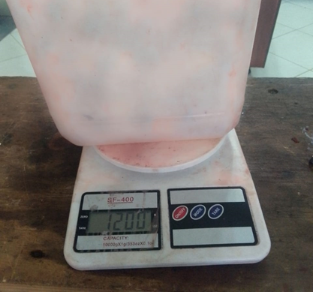
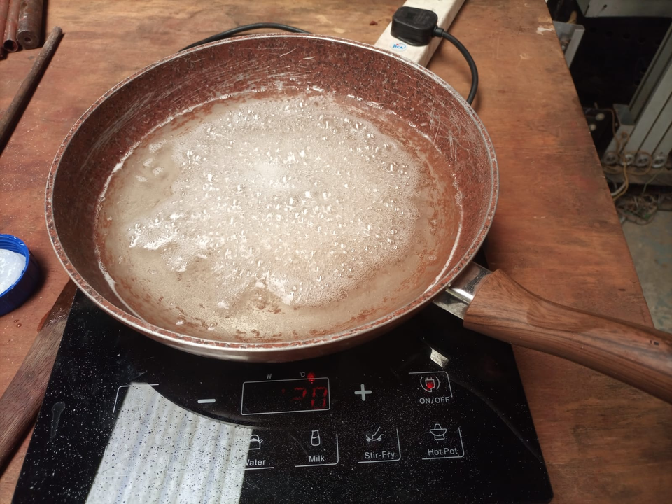
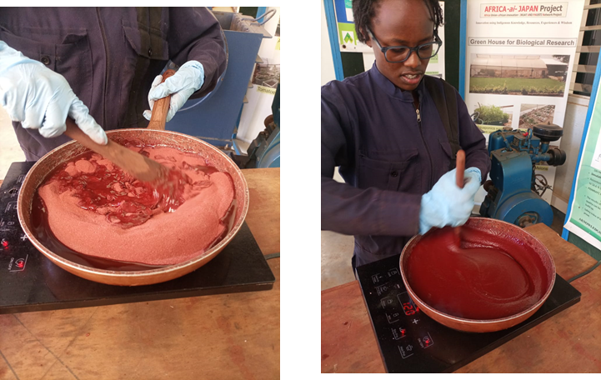
#83 Cooking of grains
Weighing the ingredients
preheating sorbitol
mixing and cookiing the mixture
cooked 6 grains with 16.98mm port diameter and one for 25mm port diameter

Slide 4
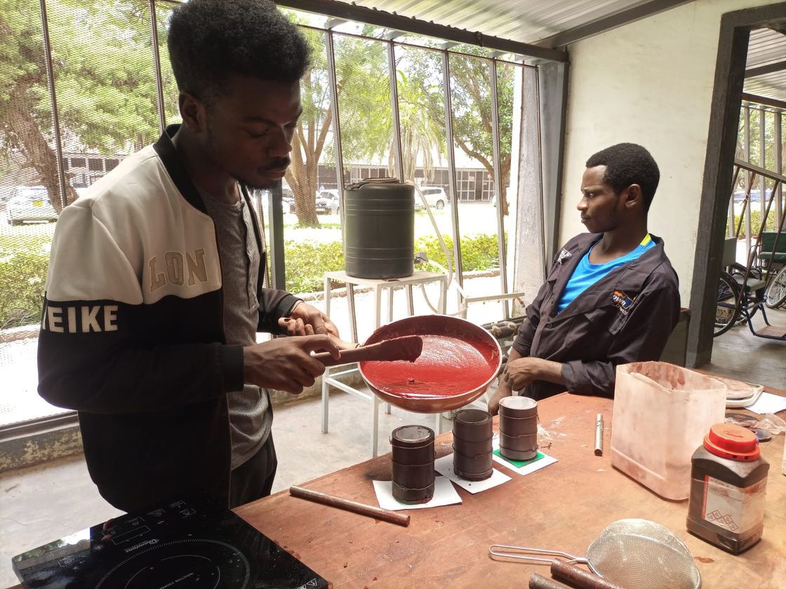
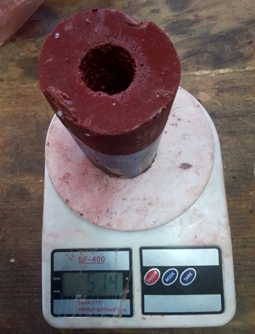
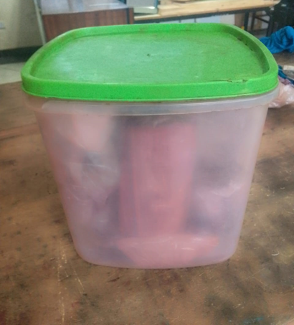
#83 Cooking of grains
demolding and weighing
Storing
Casting in molds
cooked 6 grains with 16.98mm port diameter and one for 25mm port diameter

Slide 5
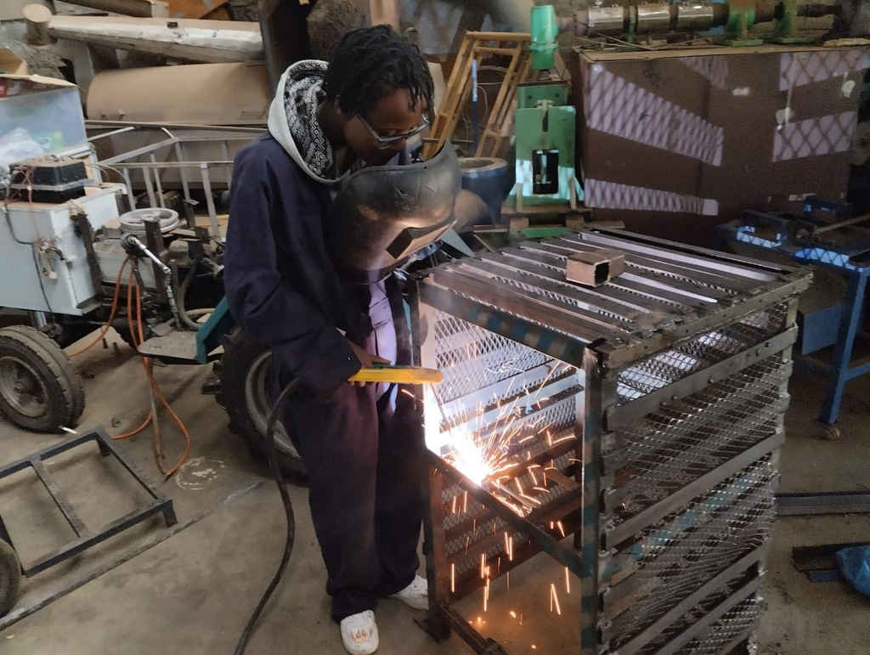
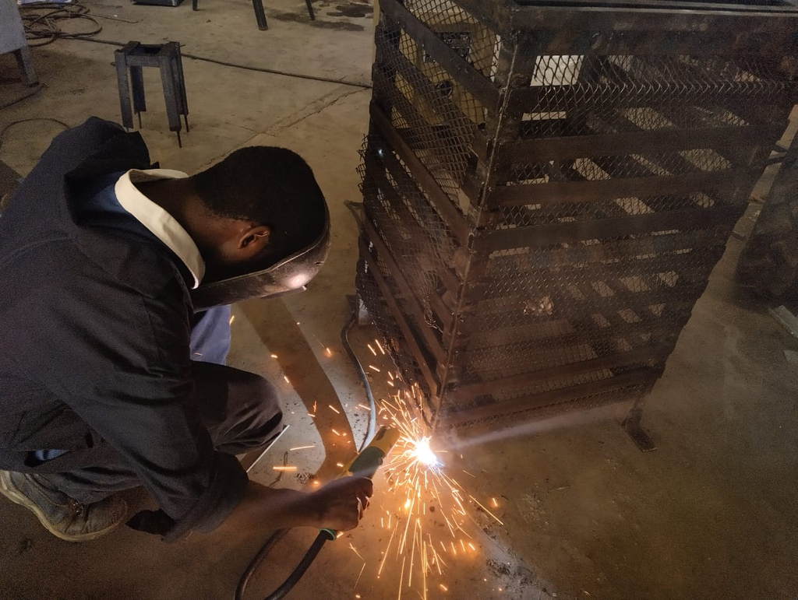
#110 Repair of test stand
The parts of the test stand destroyed during the previous static test were repaired

Slide 6
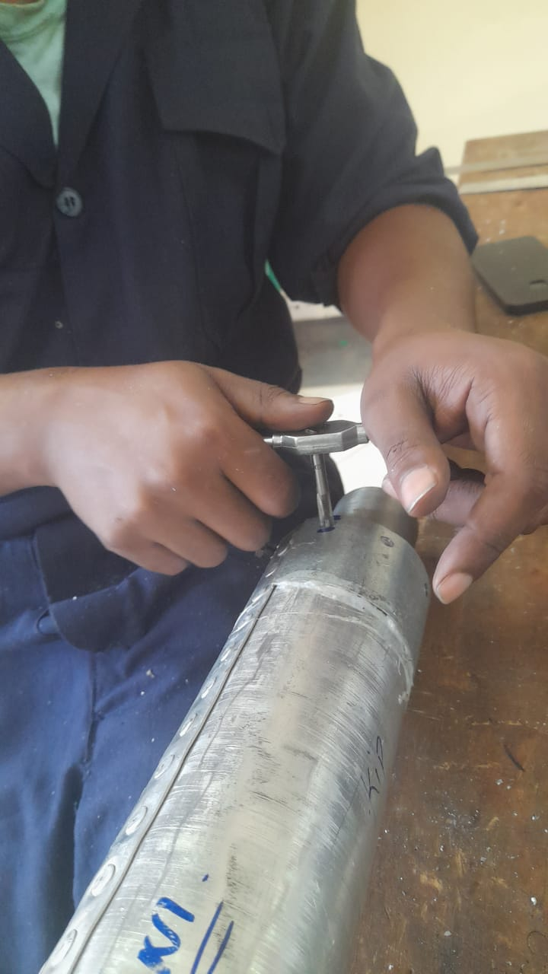
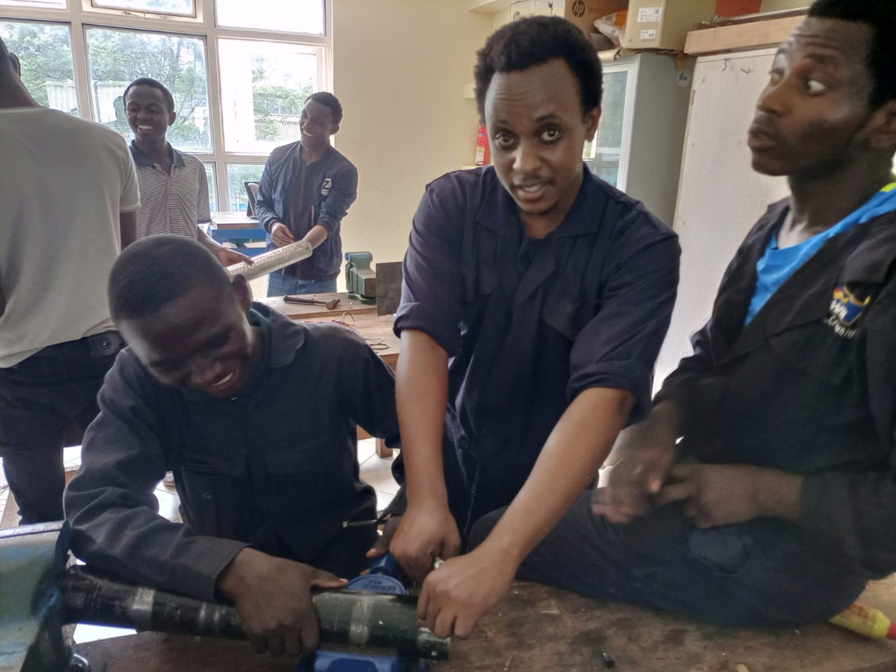
Drilling and tapping M8 holes
Drilled holes using 6mm diameter drill bit
First tapped using M7 taps
Finished tapping using M8 taps

Slide 7
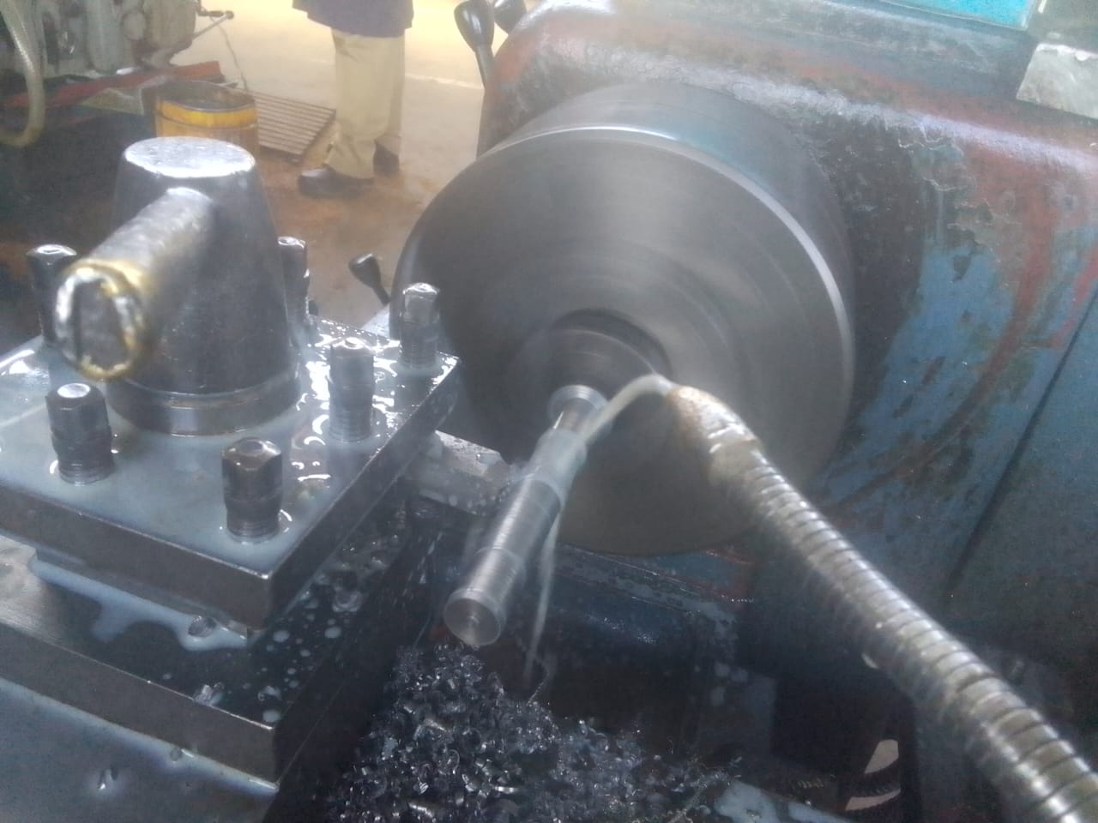
#140 Machining of casting rod
Turned one more grain casting rod from 25mm diameter shaft to 16.9mm d

Slide 8
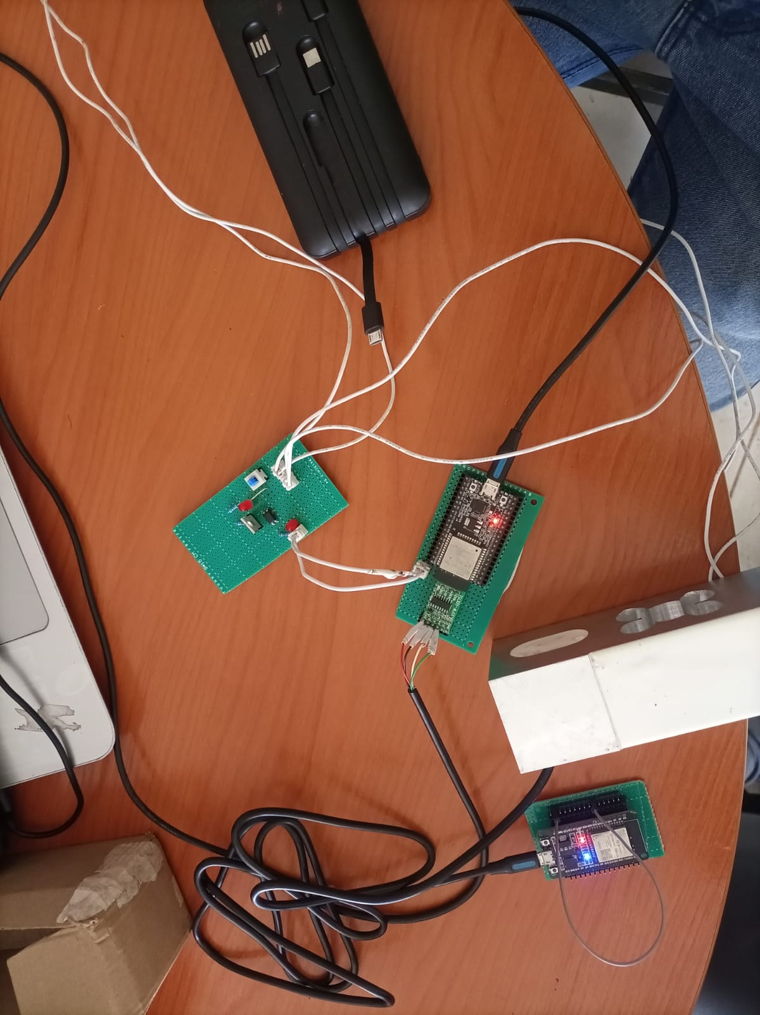
Checking ignition circuit
All the components and connections were good

Slide 9
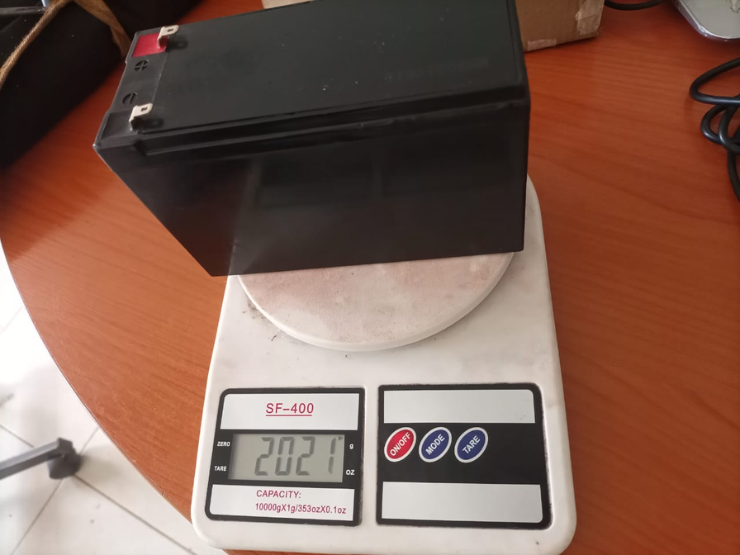
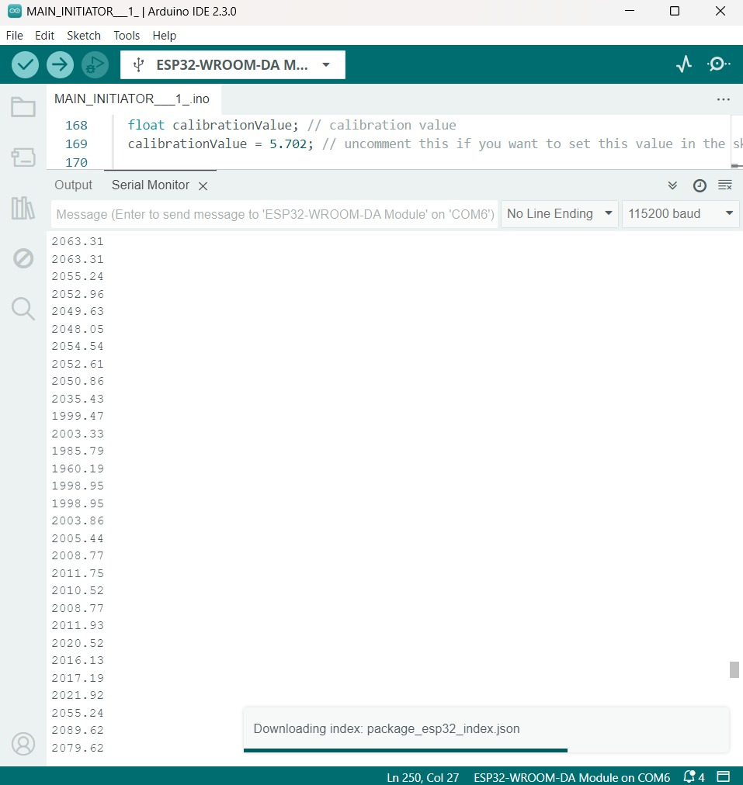
Calibrating loadcell
A known mass is used to calibrate the load cell.

Slide 10
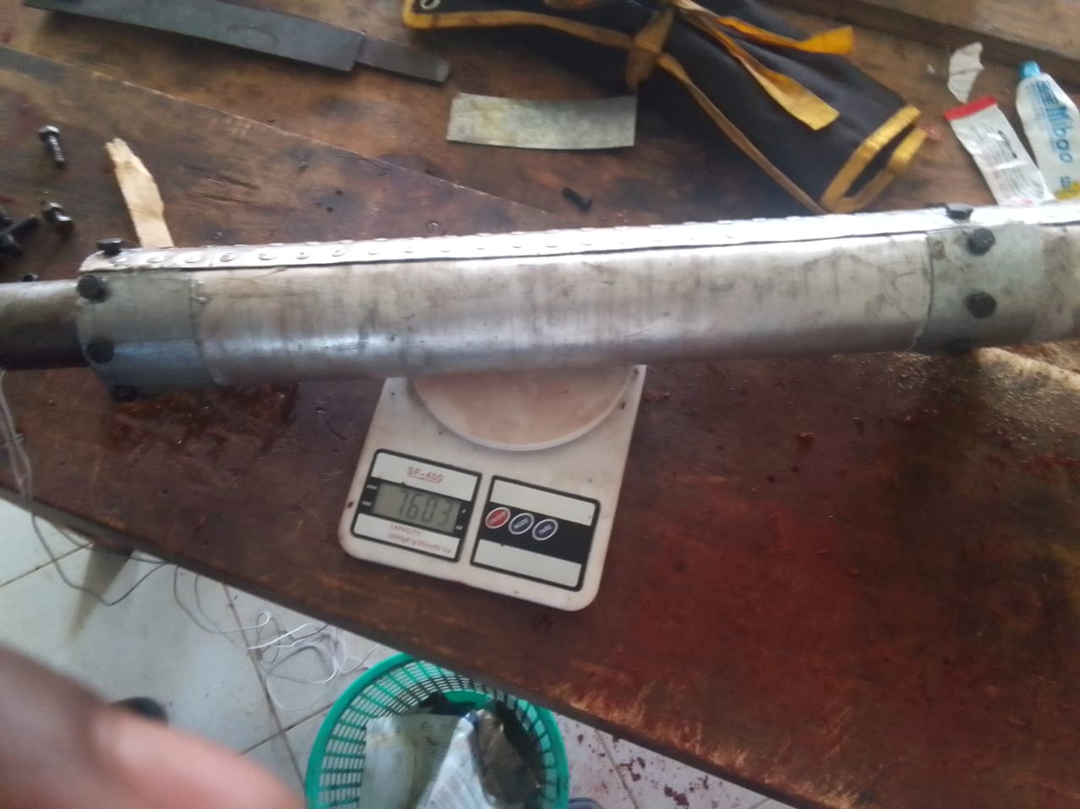
Loading of grains in motor casing
Grains with 16.98mm port diameter were loaded in the 2.5mm thick motor casing

Slide 11
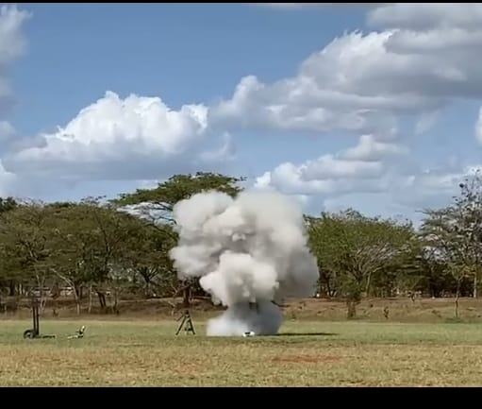
Static test
maximum thrust :407kgf
or 3992.67N
The static fire test was aimed at checking the improvement of the new grains and the strength of the 2,5mm thick motor casing

Slide 12
Tasks to be done next week
Machining of motor casing
Machining bulkheads and nozzles
Cooking of grains #83
Adding buzzers and lights in the circuit

Slide 13
THANK
YOU

